Slide 1
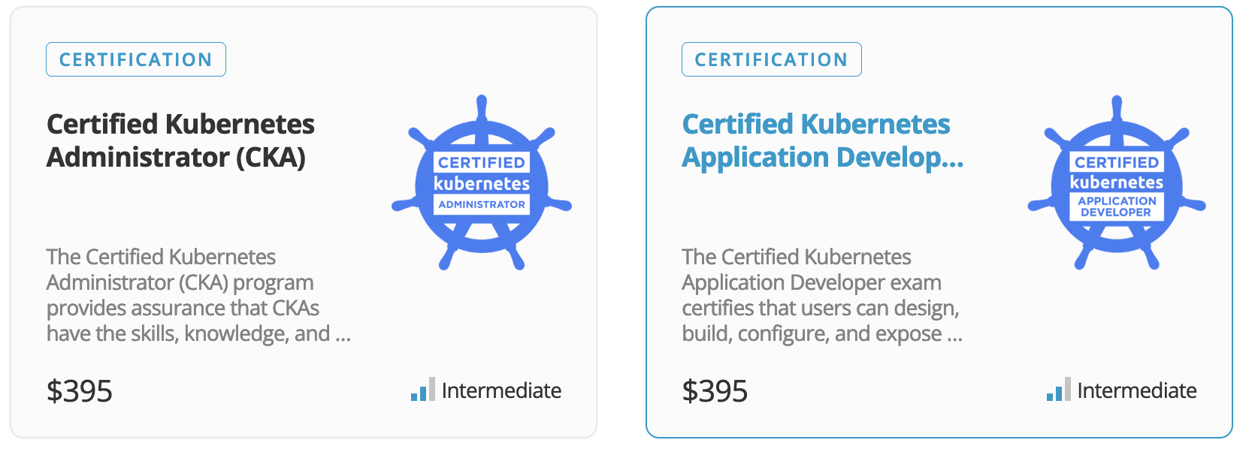

Included Enablement and Training Paths
The Linux Foundation is non-profit designed to build sustainable ecosystems around open-source projects to accelerate technology development and commercial adoption.
Included with the Rancher Multi-Cluster Manager Subscription:
1 Year Subscription to the complete Linux Foundation eLearning Catalogue
1 Individual Linux Foundation Certification
Additional subscriptions available via the RGS-Linux Foundation Customer Portal

